Slide 1



AI in the flow of human ambition
AI in the flow of
human ambition
Intelligence
Trust
Notes:
The answer is that AI has to meet people where work and ambition already happen.
It can’t require employees to cut and paste their workday into a prompt or move outside the tools and processes they use every day.
Instead, the goal is AI in the flow of human ambition — AI that amplifies people’s unique potential, accelerates ideas, and helps them create more value.
This is why we think about AI as a catalyst for human progress, not a replacement for human judgment or creativity.
[click]

Slide 2

AI in the flow of human ambition
AI in the flow of
human ambition
Intelligence
Trust
Notes:
To fully support human ambition, AI has to be built on two critical elements: intelligence and trust.
Intelligence is what helps AI understand the organization — it’s your data, your workflows, people, and business context.
Trust is what allows that intelligence to be used responsibly, securely, and with confidence. Trust must be pervasive.
Anyone can use AI to achieve outcomes that look good on paper. But intelligence and trust are the difference-makers that ultimately point to an organization’s AI success and whether leaders can consistently govern, manage, secure, measure, and scale those outcomes across every process that you have across the company.
[click]

Slide 3





Human ambition
Human ambition
Intelligence
Trust
Notes:
Here’s where we bring the story together: human ambition is the starting point, intelligence is the engine, and trust is the foundation that makes scale possible.
Frontier Transformation happens when these three elements work together across every business unit and every flow of work.
Without intelligence, AI lacks the context to drive meaningful action. Without trust, organizations can’t safely scale.
But with both, AI becomes a platform for achieving business outcomes that actually do more for humanity.
[click]

Slide 4



Intelligence
Agentic workflows
Continuous improvement
Human ambition
Intelligence
Trust
  Model diverse
  Open
  Heterogeneous
Notes:
Because businesses are not static, AI solutions can’t be static either.
Every agentic workflow must be built, observed, and tuned so it keeps improving against the outcomes the business expects — including accuracy, performance, cost, and trust.
This continuous improvement loop is central to enabling intelligence to accrue across the organization. And it needs to be model diverse, open, and heterogeneous, because you shouldn’t have to depend on one model or become locked into one layer of the stack.
The goal is to use the right model, grounded in your organization’s intelligence, to drive differentiated outcomes for your teams, your customers, and your place in the market.
[click]

Slide 5
Microsoft IQ
Agentic workflows
Continuous improvement
Copilot
Microsoft IQ
Agent 365
  Model diverse
  Open
  Heterogeneous
Notes:
Microsoft is here to support this through three connected platforms. Here’s a simple way to think about what we can offer:
First, Copilot puts AI in the flow of daily work and collaboration.
Then there’s Microsoft IQ, which empowers your organizational intelligence — your data, processes, context, and knowledge.
Agent 365 provides the trust platform for governing, observing, and managing agents across the enterprise.
Together, these capabilities help your business build AI that is useful in the moment, grounded in your own business context, and trusted enough to scale.
[click]

Slide 6

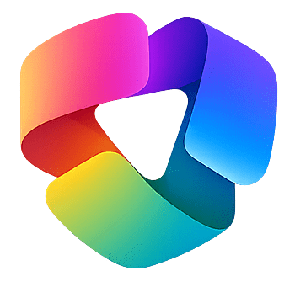
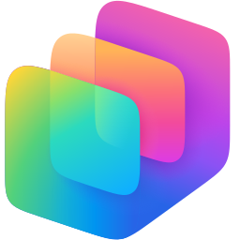
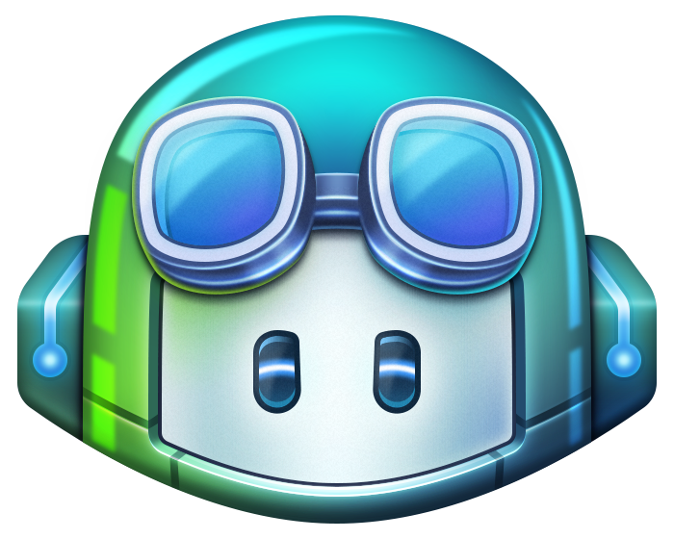
AI in the flow of human ambition
Copilot
Microsoft 365 Copilot
Copilot Cowork
Autopilots
Copilot Studio
GitHub Copilot
Notes:
Here, we can unpack Copilot as one connected experience that supports you in different ways at every step of your daily journey.
For example, Microsoft 365 Copilot supports employees in the apps and collaboration surfaces they already use.
Copilot Cowork helps people delegate semi-autonomous tasks and get more done.
Autopilots introduce longer-running digital workers that can operate on behalf of the user.
And for builders, Copilot Studio and GitHub Copilot come together under the broader Copilot experience.
The big idea here is that Copilot is not a single assistant; it is a platform for human-AI collaboration across work, tasks, and development.
[click]

Slide 7
Intelligence platform
Your IQ
Notes:
Now let’s take a moment to talk about how your IQ fits into all of this.
When we say ‘your IQ,’ we mean your organization’s unique intelligence — the knowledge, data, relationships, workflows, records, and business logic that make your company distinct.
What we see over and over again is that successful Frontier Transformation depends on AI that compounds from within the organization, rather than generic intelligence that accrues value elsewhere.
In short, your advantage comes from activating the intelligence you already have.
[click]

Slide 8
Intelligence platform
Your IQ
Microsoft IQ
Work IQ
Web IQ
Foundry IQ
Fabric IQ
Notes:
Now here’s where we bring our intelligence to work alongside yours.
Microsoft IQ is the platform that brings organizational intelligence together.
It spans Work IQ, Web IQ, Foundry IQ, and Fabric IQ, giving different audiences the right level of precision and access.
For information workers, it simplifies access to enterprise intelligence in the flow of work. For developers, it provides deterministic context across knowledge, data, web signals, and business workflows.
This is how Microsoft helps AI reason from your own unique context, not just from a model’s general knowledge.
[click]

Slide 9
Work IQ
How
you work
With whom
you work
Business Applications
Content
Notes:
Work IQ was the first expression of this intelligence platform — the brain inside Microsoft 365 Copilot.
It understands how people work, who they work with, and the content they collaborate on.
That matters because AI becomes more useful when it can reason over real work context: meetings, documents, chats, relationships, and collaboration patterns.
This is what allows Copilot to move from generic responses to assistance that reflects how work actually gets done.
What’s also noteworthy is that Work IQ now includes business applications logic and data from CRM and ERP systems.
That means Copilot can understand not only how people work and what content they use, but also the business flows that matter most — like sales, service, finance, supply chain, or operations.
For you and your business, this is the bridge between productivity AI and business process transformation. AI can act with more precision because it understands both work context and business context.
[click]

Slide 10
Intelligence platform
Your IQ
Microsoft IQ
Work IQ
Web IQ
Foundry IQ
Fabric IQ
Notes:
Now let’s return to the broader Microsoft IQ story for a closer look at how the remaining pieces fit together.
We know that Work IQ brings in the human and business flows of work.
Web IQ connects to external signals like weather, tariffs, shipping, or market dynamics.
Foundry IQ is where enterprise knowledge can be grounded and used by agents.
And Fabric IQ helps connect system-of-record data wherever it lives.
Together, these IQ layers give customers a more complete intelligence platform for building and running AI across the enterprise.
[click]

Slide 11


Trust platform
Agent 365
Admin | SecOps | FinOps
Foundry
AI Engineers
Microsoft Defender
Security professionals
Observability at every layer of the stack
Notes:
Trust is the other half of the equation.
Microsoft’s position is that observability has to exist at every layer of the AI stack.
IT admins need visibility to govern and manage AI. SecOps teams need to secure AI. FinOps teams need to understand usage and ROI. AI engineers need to observe and evaluate agent behavior in Foundry. Security professionals need Defender to protect agents and AI-enabled workflows.
Agent 365, Foundry, and Microsoft Defender together make trust operational across roles.
[click]

Slide 12

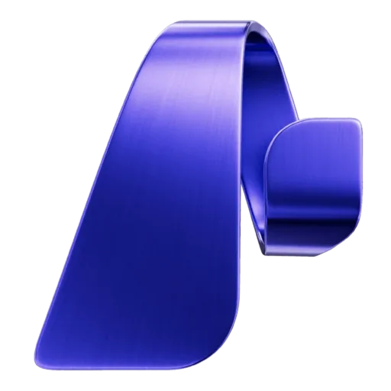
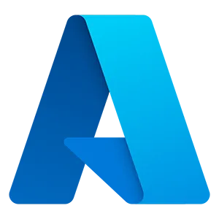
Empowering Frontier Transformation
Agentic workflows
Continuous improvement
Your IQ
Microsoft IQ
Copilot
Agent 365
Foundry
Azure
Fabric
Security
Notes:
The examples we just looked at show outcomes; when we return to this view, we once again see the system that makes those outcomes repeatable.
Copilot enables AI in the flow of work. Microsoft IQ grounds AI in the organization’s unique intelligence. Agent 365 provides the trust layer. Azure, Fabric, Foundry, and Security support the data, development, governance, and protection required to scale.
The big understanding here is that Frontier Transformation requires a connected platform, not disconnected tools.
[click]

Slide 13
Take your next step toward Frontier Transformation
Explore use cases by business function & industry
Go deeper with a Frontier Discovery Workshop
Accelerate your journey with Microsoft Frontier Company
Notes:
We want to understand your goals and needs and work with you to build and execute the right plan accordingly.
And this is where we’re excited to engage with you, in a way that meets your needs in goals, whether that’s understanding the use cases that are most critical for you, assessing your AI readiness, or developing an overall AI and agentic strategy
So where would you like to go from here?
INTERNAL NOTES:
Customize the next steps based on where your customer is on their journey:
There are a number of internal sites and resources to help your customer prepare:
Continue the sales journey with one of the 8 Conversations: Conversations Hub (aka.ms/ConversationHubs)
Explore Industry Use Cases: Industry Hub: (aka.ms/IndustryHub)
Assess your AI Readiness and priorities with the Frontier Discovery Workshop: (https://aka.ms/DiscoveryWorkshopKit)
Engage your team on working with Services or Microsoft Frontier Company: (https://microsoft.sharepoint.com/sites/ServicesSalesHub/SitePages/Services%20Seller%20Hub.aspx)

